Slide 1
House Price Prediction
Presented by: Christoph Rendel
Elizabeth Shogbanmu
April 2022

Slide 2

King County, Washington
Population- 2,269,675(Census 2020)-Most populated in Washington
Area-2,307 sq miles
490 square km water bodies
Highest Mountain- Mount Daniel 2,426m

Slide 3
Table of Contents
Introduction -Research Question
-Objective of Study
Data set
Data Processing Pipeline
Insights/Findings
Conclusion
Outlook

Slide 4
Content Title 02
RESEARCH QUESTION/OBJECTIVE
DATA SET
The data set contains records of 21,597 houses sold in King County and 21 features
On the average, the house price for a 3bedroom house(which is the most common based on count) is $466,277
Price is the target variable and other features include structure and location.
What are the features that influence high property value?
To build a model that will predict the price of houses based on these features.

Slide 5
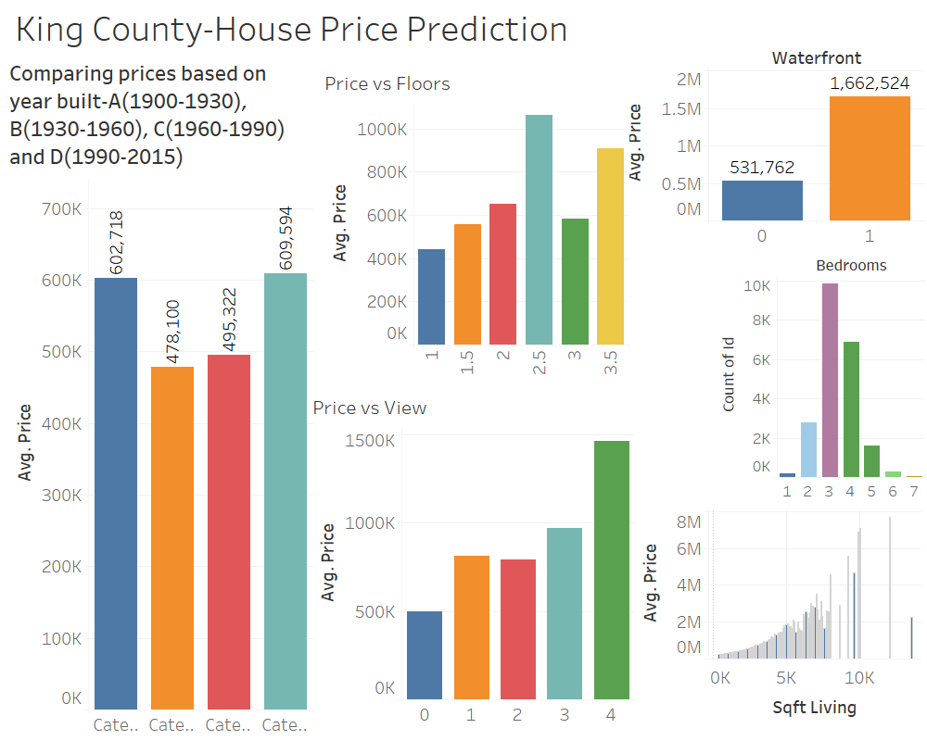
Data Overview

Slide 6
Data Pipeline
Data Source
Data Processing
-Transform to Normal Distribution, Remove Outliers, One-Hot Encoding
Apply Model
-Linear regression
Improve Model
-Removing non- significant features
Visualize Results

Slide 7
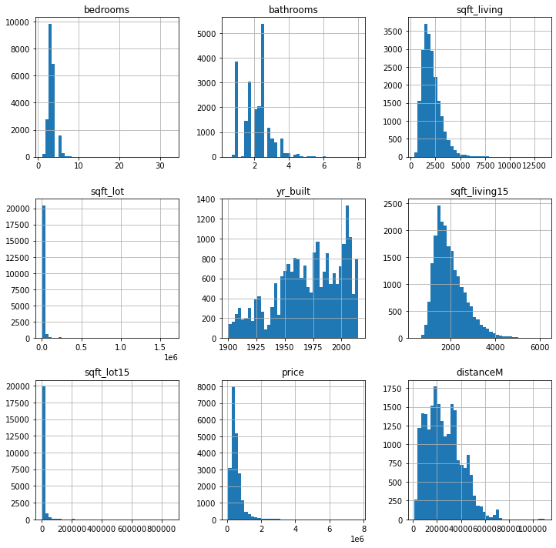
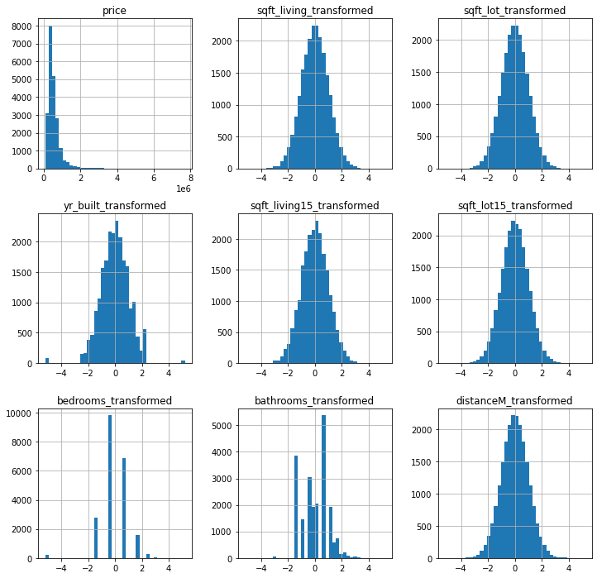
Before and After Modelling-Histograms

Slide 8
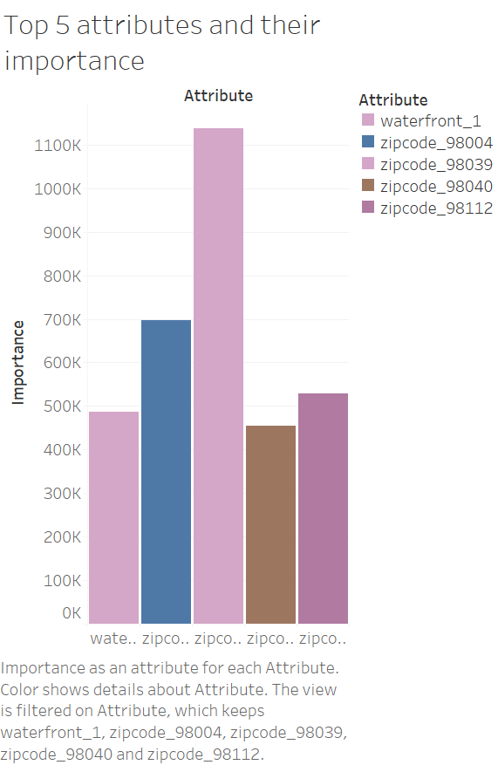
Modelling Effect

Slide 9
Adjusted R2
MSME

Slide 10
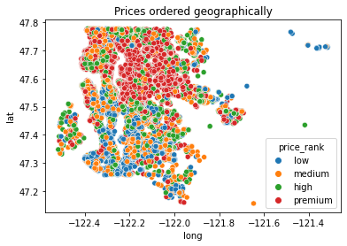
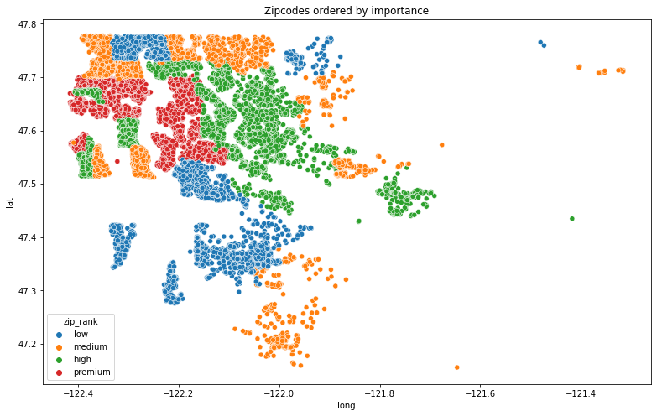

Slide 11
Insight/Findings

Slide 12
Conclusion
Features which include waterfront, living room sq/ft, and geographical location(zip-code) of the houses affect Price

Slide 13

Outlook

Slide 14
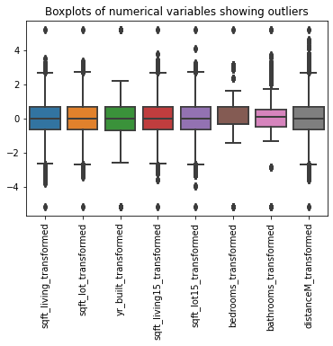
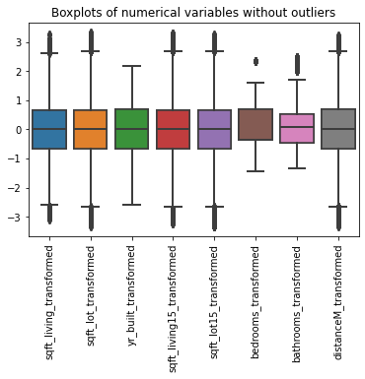
Removing Outliers

Slide 15
Useful Links

Slide 16
Thank You!

